Slide 1
Numpy

Slide 2
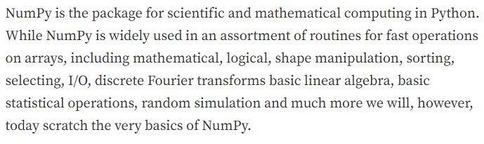
Numpy Basics

Slide 3
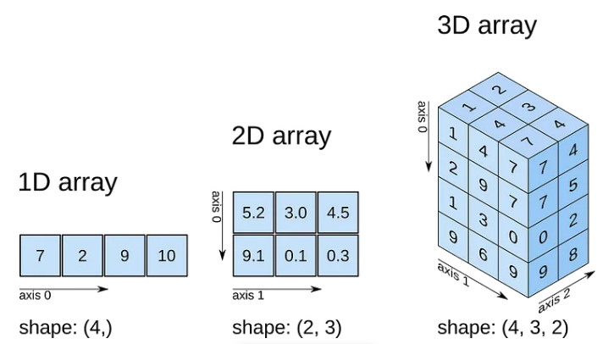
Dimensions of Numpy Array

Slide 4
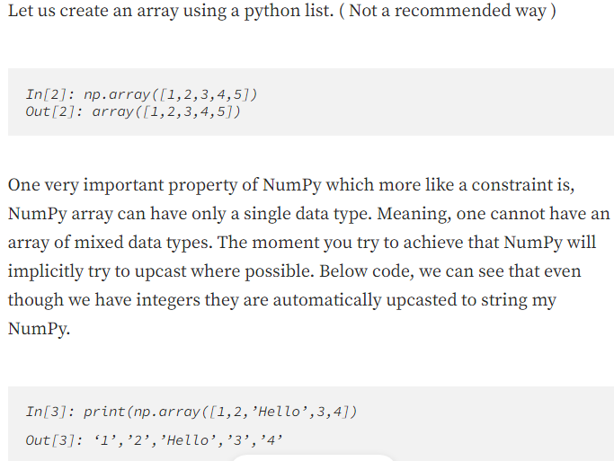
Numpy One Dimensional Array

Slide 5
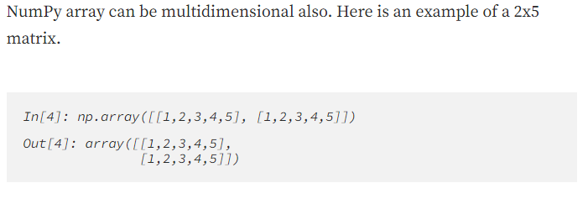
Two Dimensional Array

Slide 6
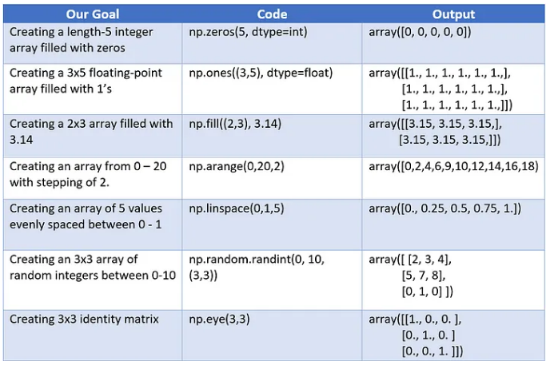
Creating Arrays using built-in routines

Slide 7
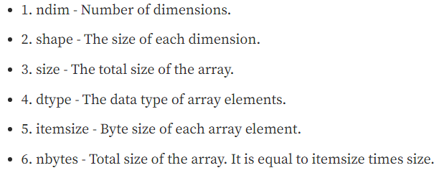
Numpy Attributes

Slide 8
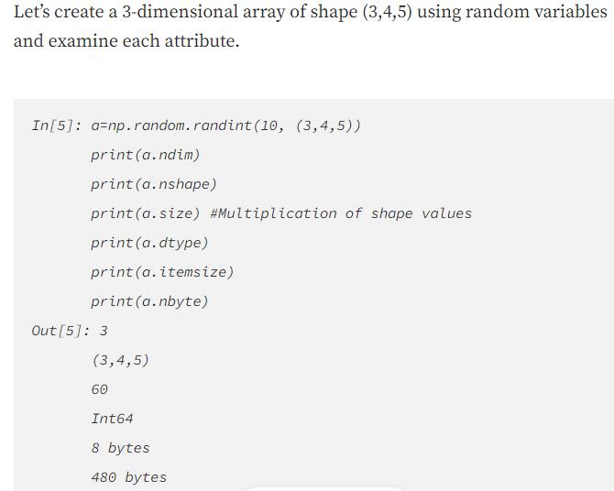
Numpy Attributes

Slide 9
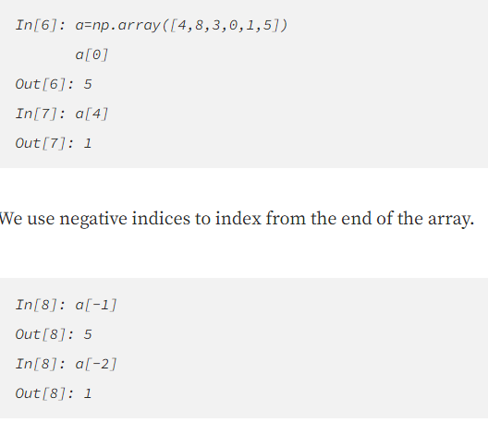
Array Indexing

Slide 10
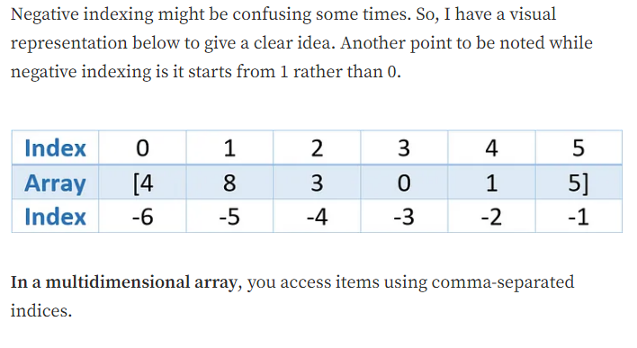
Array Indexing

Slide 11
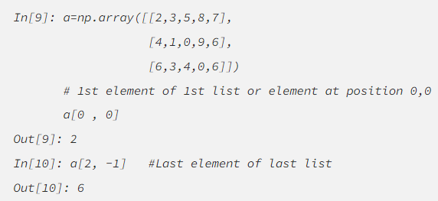
Array Indexing

Slide 12
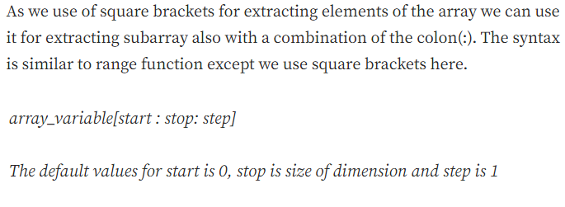
Array Slicing

Slide 13
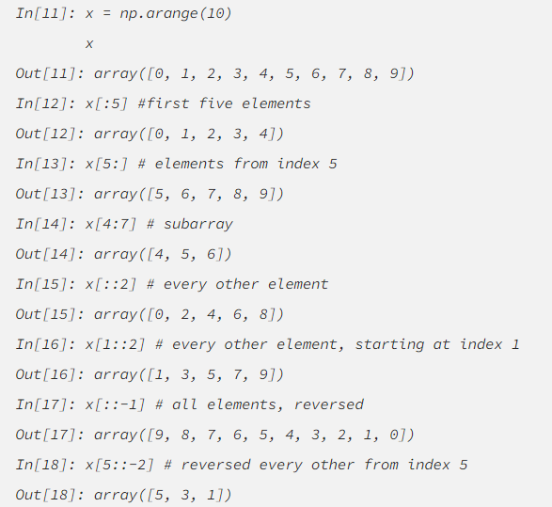
Array Slicing

Slide 14
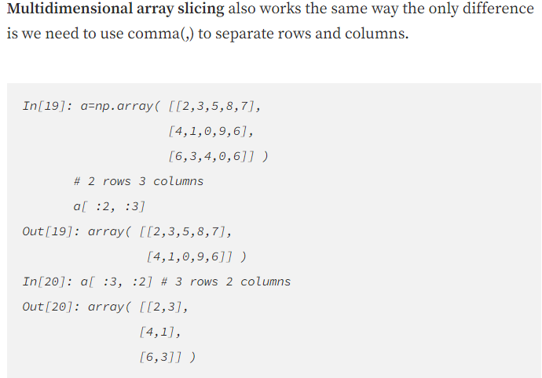
Array Slicing

Slide 15
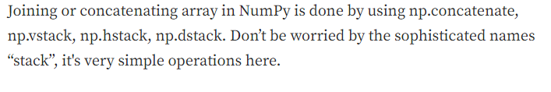
Array Concatenation and Splitting

Slide 16
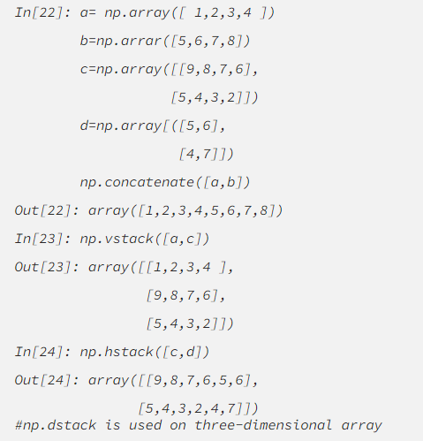
Array Concatenation and Splitting

Slide 17

Array Concatenation and Splitting

Slide 18
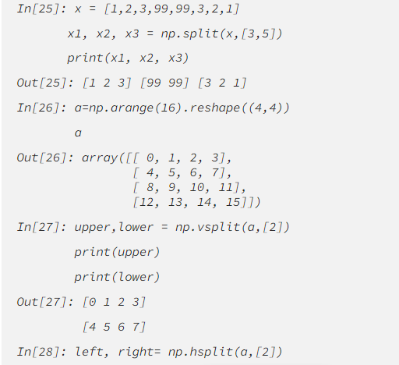
Array Concatenation and Splitting

Slide 19
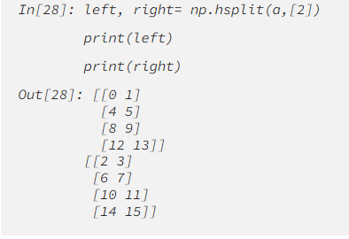
Array Concatenation and Splitting

